Slide 1
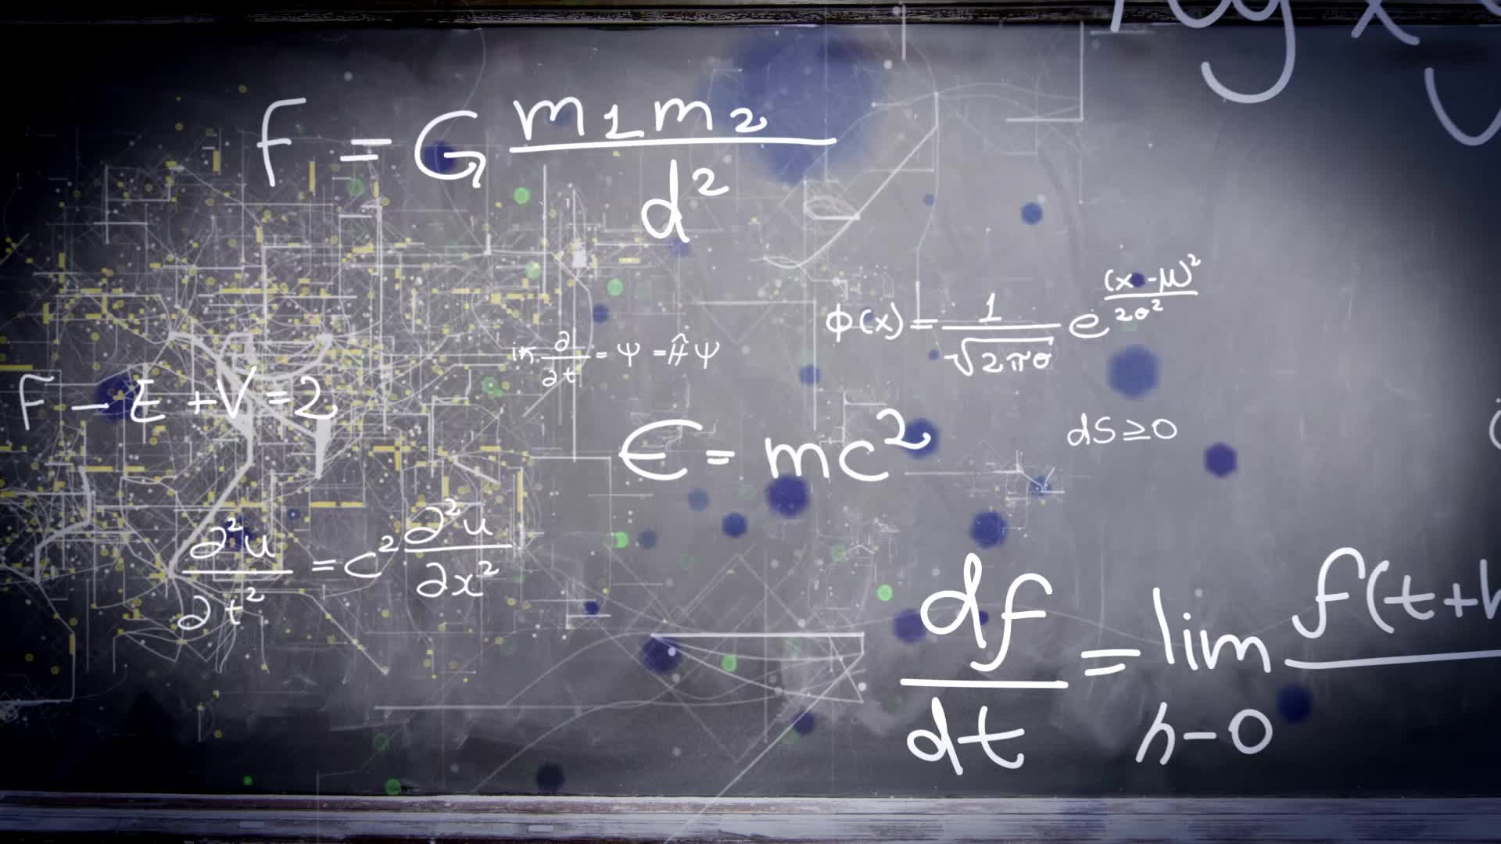
Chapter 3.4:
Concavity and The Second Derivative Test
HONORS CALCULUS/CALCULUS

Slide 2
The Second Derivative Test For Concavity
If $f^{′′}\left(x\right)>0$ for all $x∈I$, then f is concave up.
If $f^{′′}\left(x\right)<0$ for all $x∈I$, then f is concave down.

Slide 3
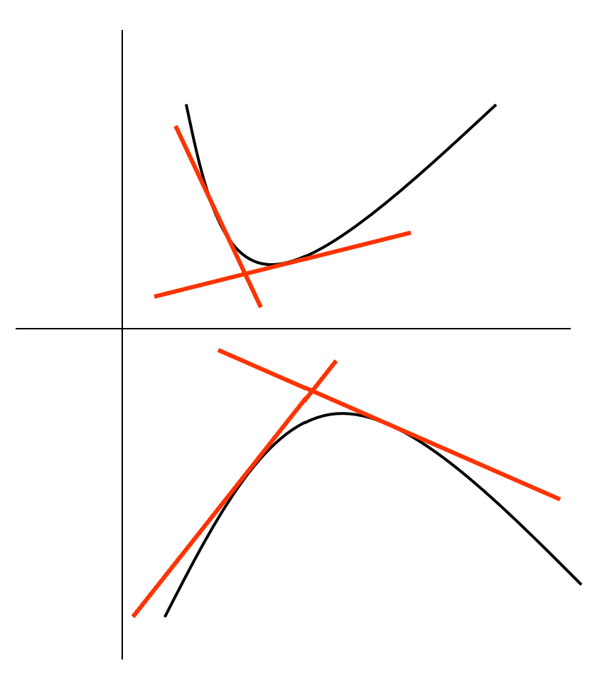
The Second Derivative Test For Concavity
Concave Up: f’ is increasing. Tangent lines are below the graph.
Concave Down: f’ is decreasing. Tangent lines are above the graph.

Slide 4
Point of Inflection
If the graph of a continuous function possesses a tangent line at a point where its concavity changes from upward to downward (or vice versa) we call the point a POINT OF INFLECTION.
If $(c,f\left(c\right))$ is a point of inflection of the graph of f, then either$f^{′′}\left(c\right)=0$ or f’’ is undefined at $x=c$.

Slide 5
Ex. 1) Determine the open intervals on which the graph of $f\left(x\right)=6{\left(x^{2}+3\right)}^{−1}$ is concave up or down.

Slide 6
Ex. 2) Determine the points of inflection and discuss the concavity of the graph of $f\left(x\right)=x^{4}−4x^{3}$.

Slide 7
The Second Derivative Test
A Useful Shortcut: The Second Derivative Test for Relative Extreme Values (Use Critical Numbers of 1st Derivative)
If $f^{′′}\left(c\right)>0$, then $f(c)$ is a relative min.
If $f^{′′}\left(c\right)<0$, then $f(c)$ is a relative max.
If $f^{′′}\left(c\right)=0$, then the test fails. No min. or max.

Slide 8
Ex. 3) Find the relative extrema for $f\left(x\right)={−3x}^{5}+5x^{3}$. Apply the 2nd Derivative Test.

Slide 9
Ex. 4) A) Find the Critical Numbers of f (if any), B) find the open intervals on which the function is increasing/decreasing, C) apply the First Derivative Test to identify all relative extrema, D) find the open intervals on which the function is concave up or down, E) find the points of inflection (if any):
$f\left(x\right)=x^{4}−12x^{3}+48x^{2}−64x$
$$f′\left(x\right)=4\left(x−1\right){\left(x−4\right)}^{2}$$
$$f′′\left(x\right)=12\left(x−4\right)(x−2)$$

